Slide 1

Bright Motors Car Sales Analysis
Prepared by Anelisa Dlamini

Slide 2
Project Objectives
To identify top revenue-generating makes and models
To analyse relationship between price, mileage, and year
To assess regional performance
To identify emerging customer trends
To recommend strategies to improve profitability

Slide 3
Revenue Insights
Explorer Sport Trac generated the highest total revenue.
This model should be prioritized for:
Stocking Marketing campaigns
Supplier negotiations
Potential to become a flagship model

Slide 4
Price vs Mileage
Selling price decreases as mileage increases.
Customers value low-mileage cars, meaning Bright Motors should:
Apply tiered pricing strategies based on mileage.
Promote low-mileage vehicles heavily.
Add value to high-mileage cars via warranties or service packages

Slide 5
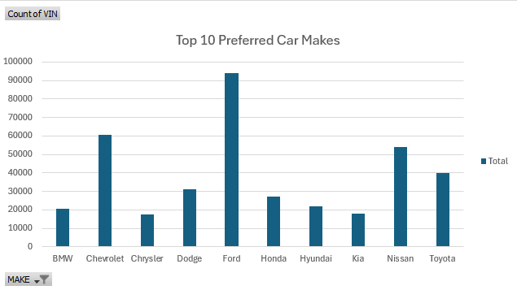
Customer Preference Trends
Ford is the most preferred and purchased car make.
Bright Motors should:
Prioritize stocking Ford vehicles.
Strengthen relationships with Ford suppliers.
Create Ford-focused seasonal promotions

Slide 6
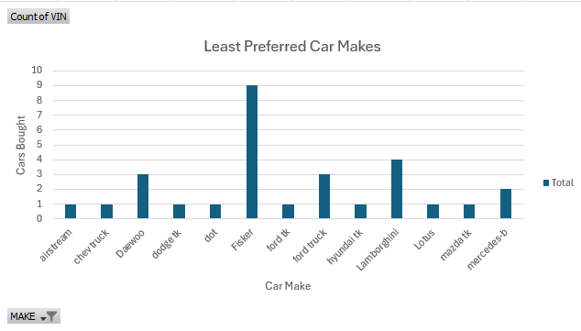
Customer Preference Trends
This graph shows the least preferred cars.
Airstream, chev truck, dodge tk, dot, ford tk, hyundai tk, Lotus and mazda tk, are the least purchased cars, with just one purchase per car make.
These makes show very low demand and may cause slow moving inventory and higher carrying costs
Bright Motors should reduce stocking and clear remaining units using discounts or trade-in deals

Slide 7
Recommendation
Optimize inventory: focus on high performing models
Introduce dynamic pricing strategies
Expand dealership network in high potential areas
Leverage data dashboards for real time decision making

